Slide 1
Python Course for Physicists Chunk 2: Variables
By Jonathan Bollig
08.10.2025
Notes:
For People who have basic experience in Python, this will be a little boring.
But important, to get everyone on the same page

Slide 2





Live Coding: Text Output – Printing
Print Statement:
Print Numbers:
Saving Data into Memory: Variables

Slide 3
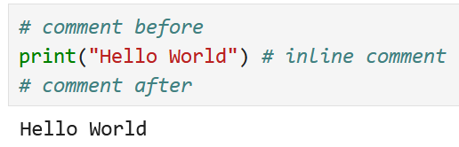
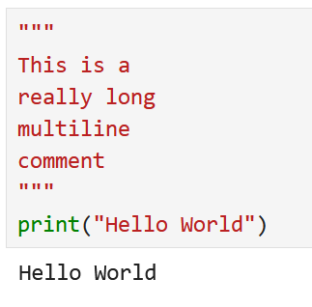
Live Coding: Comments
Comments don’t get executed → Ignored by the program
Single line comment: #
Can be at end of line (inline)
Multiline comment: """ … """

Slide 4
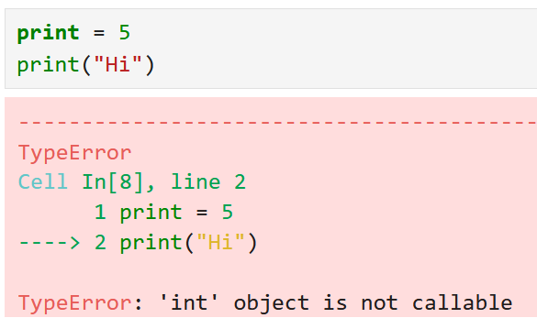
Variables Names:
Usually alphanumeric + “_” → a, tree, house99, tree_house1.
First character cannot be number → Forbidden: 1house
Reserved Keywords (don‘t use): According to ChatGPT: False, None, True, and, as, assert, async, await, break, case, class, continue, def, del, elif, else, except, finally, for, from, global, if, import, in, is, lambda, match, nonlocal, not, or, pass, raise, return, try, while, with, yield
DON’T:

Slide 5


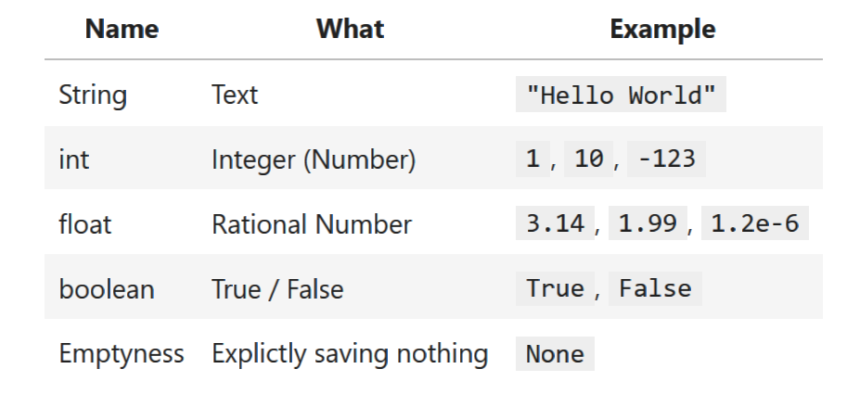
What’s the difference: &
→ Different “types” of Data
Single or Double Quotes
Btw. complex numbers are noted by “j”:
X = 4j

Slide 6
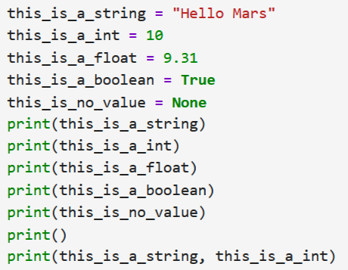
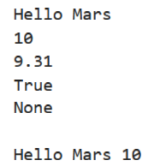
What’s the difference: &
Separating print arguments by “,” prints them with a Whitespace inbetween

Slide 7
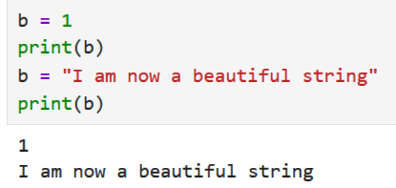


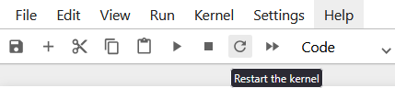
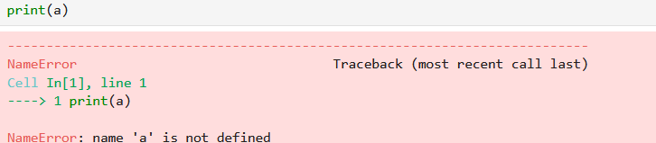
Reassignment / Memory / Restarting Kernel
Reassignment:
Memory: ⚡
Restarting the kernel → Delete Memory:
Notes:
Always look at the last line

Slide 8

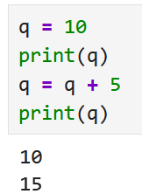
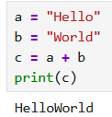

Live Coding: Arithmetic Operators
Example with Integers:
→ Adding to itself possible
Example with Strings:
Multiplying a String:
Notes:
Mathematical Wrong Statement works semantically

Slide 9
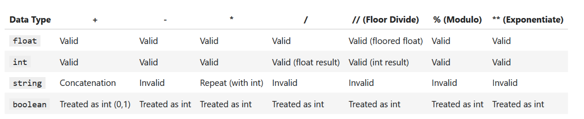
Arithmetic Operators: Complete List

Slide 10

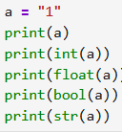
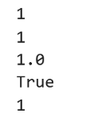
Type Conversion: Type Parsing
Determine type of (unknown) variable:
Converting the Type:

Slide 11
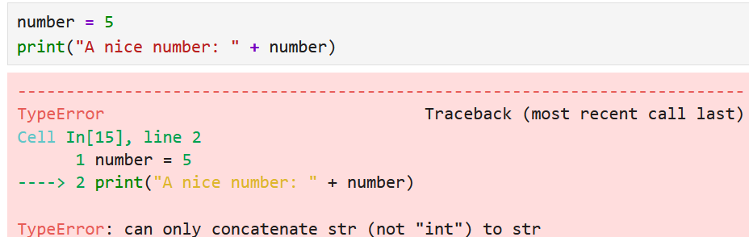
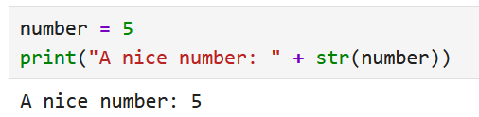
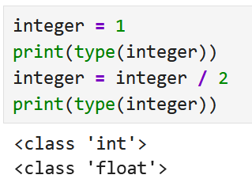
Live Coding: Type Conversion: Type Parsing
Why is this useful? → Concatenate string and int:
Type Parsing int → str fixes the problem:
A lot of type parsing happens automatically:

Slide 12
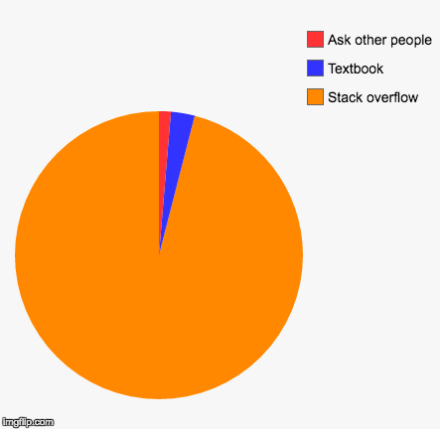

Some notes on solving task sheets
Splitting into second room
If you get stuck:
Try yourself again
Ask your neighbor
Ask assistants
If busy: Ask google (Stackoverflow <3)
(Maybe) ask LLM (ChatGPT / Perplexity / Copilot)
Look into solution file
Struggling and debugging are 90% of a coders work
[Deleted User on Reddit]
Good Luck ☺
[Programmerhumor.io]
Notes:
Comment on collapsing Cells (to remove the summary)

